Slide 1
Source Code Control using git
Prof. Darrell Long
CSE 13S

Slide 2
What is git?
It is a Source Code Control system.
It tracks files and the changes to those files.
It is a collaboration tool.
It allows multiple people to work independently and then merge their work.
It is your best friend
When you lose a file, or
When you mess things up and want to go back.

Slide 3
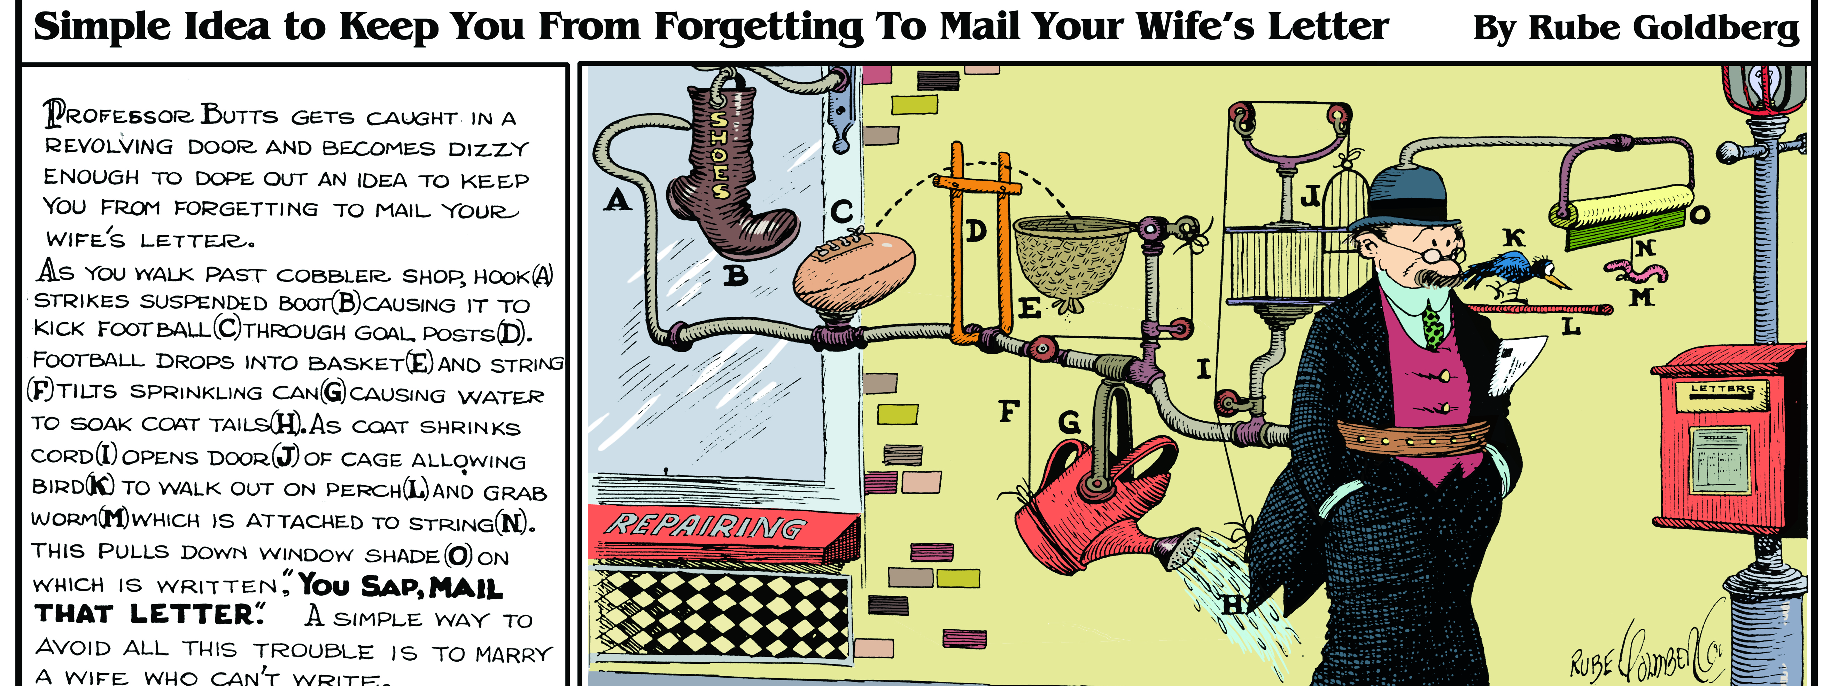
Warning: git can be complicated!
Notes:
Credit: Rube Goldberg

Slide 4
What is ssh?
It is a family of programs that let one computer communicate with another.
ssh — Secure Shell
scp — Secure Copy
sftp — Secure FTP
Data is compressed and encrypted before sending it over the network.
Authentication is provided by Public Key Cryptography.

Slide 5
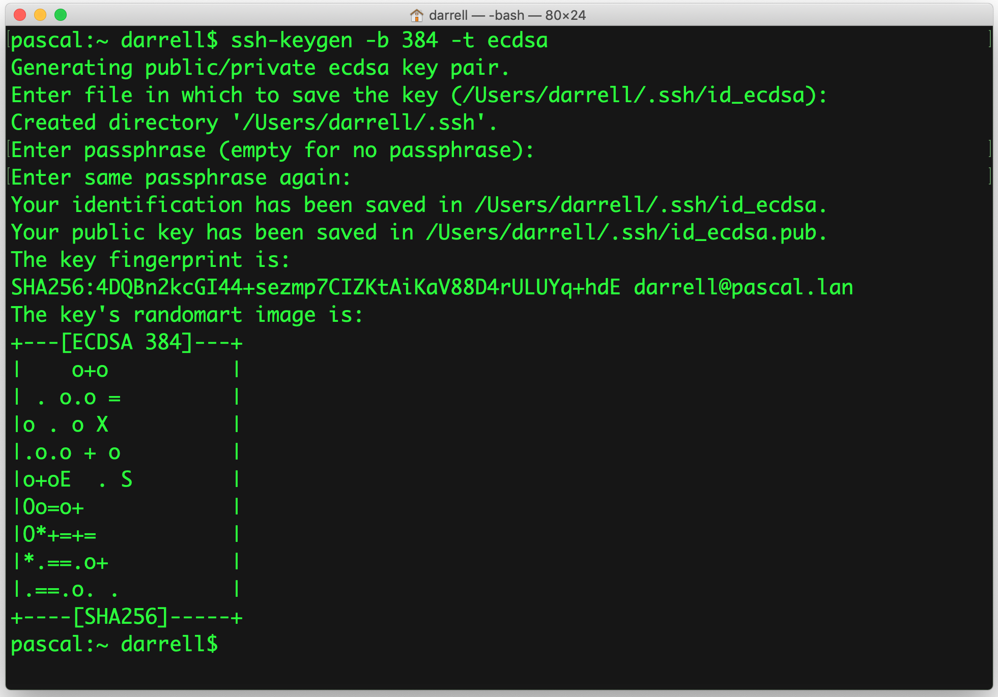
Create an ssh key
You may want to use RSA instead

Slide 6
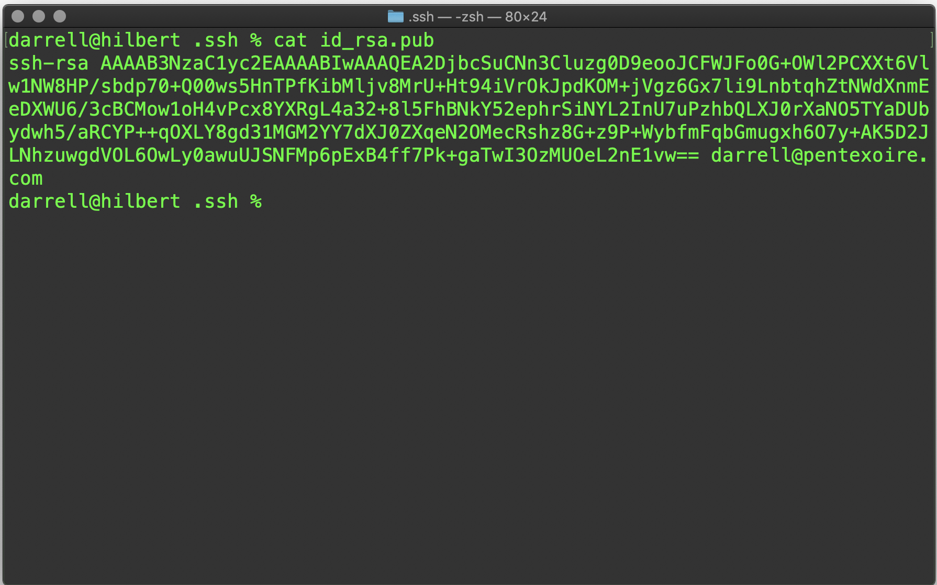
ssh Public Key

Slide 7
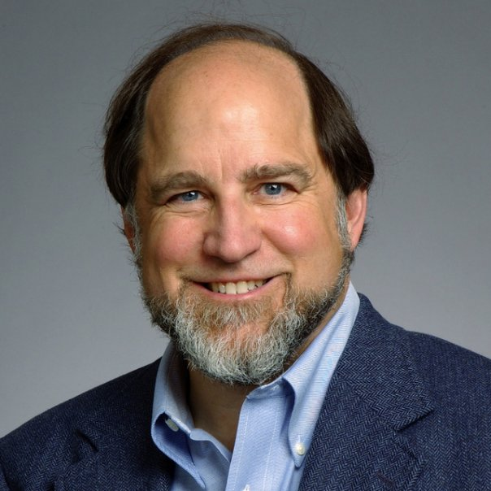

What is RSA?
Public Key cryptography
There is a public key and a private key
Choose very large primes $p$ & $q$
$n=p × q$
$e$ is a random prime
$e × d ≡1 \left(mod\right)(p−1)(q−1)$
Encryption: $E\left(m\right)=m^{e} mod n=c$
Decryption: $D\left(c\right)=c^{d} mod n=m$
$E\left(D\left(x\right)\right)=D\left(E\left(x\right)\right)=x$
Ron Rivest

Slide 8
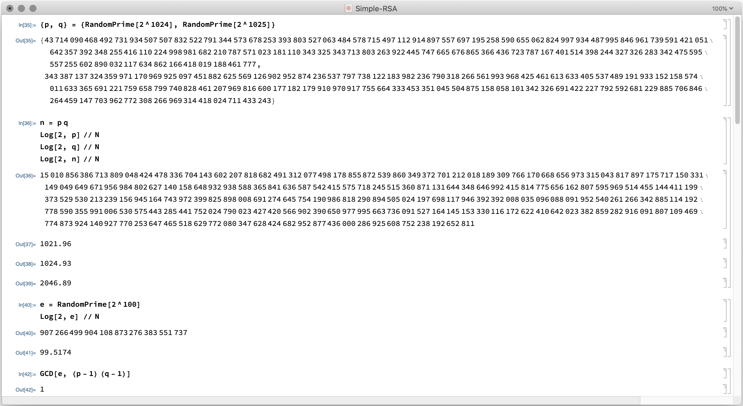

Slide 9
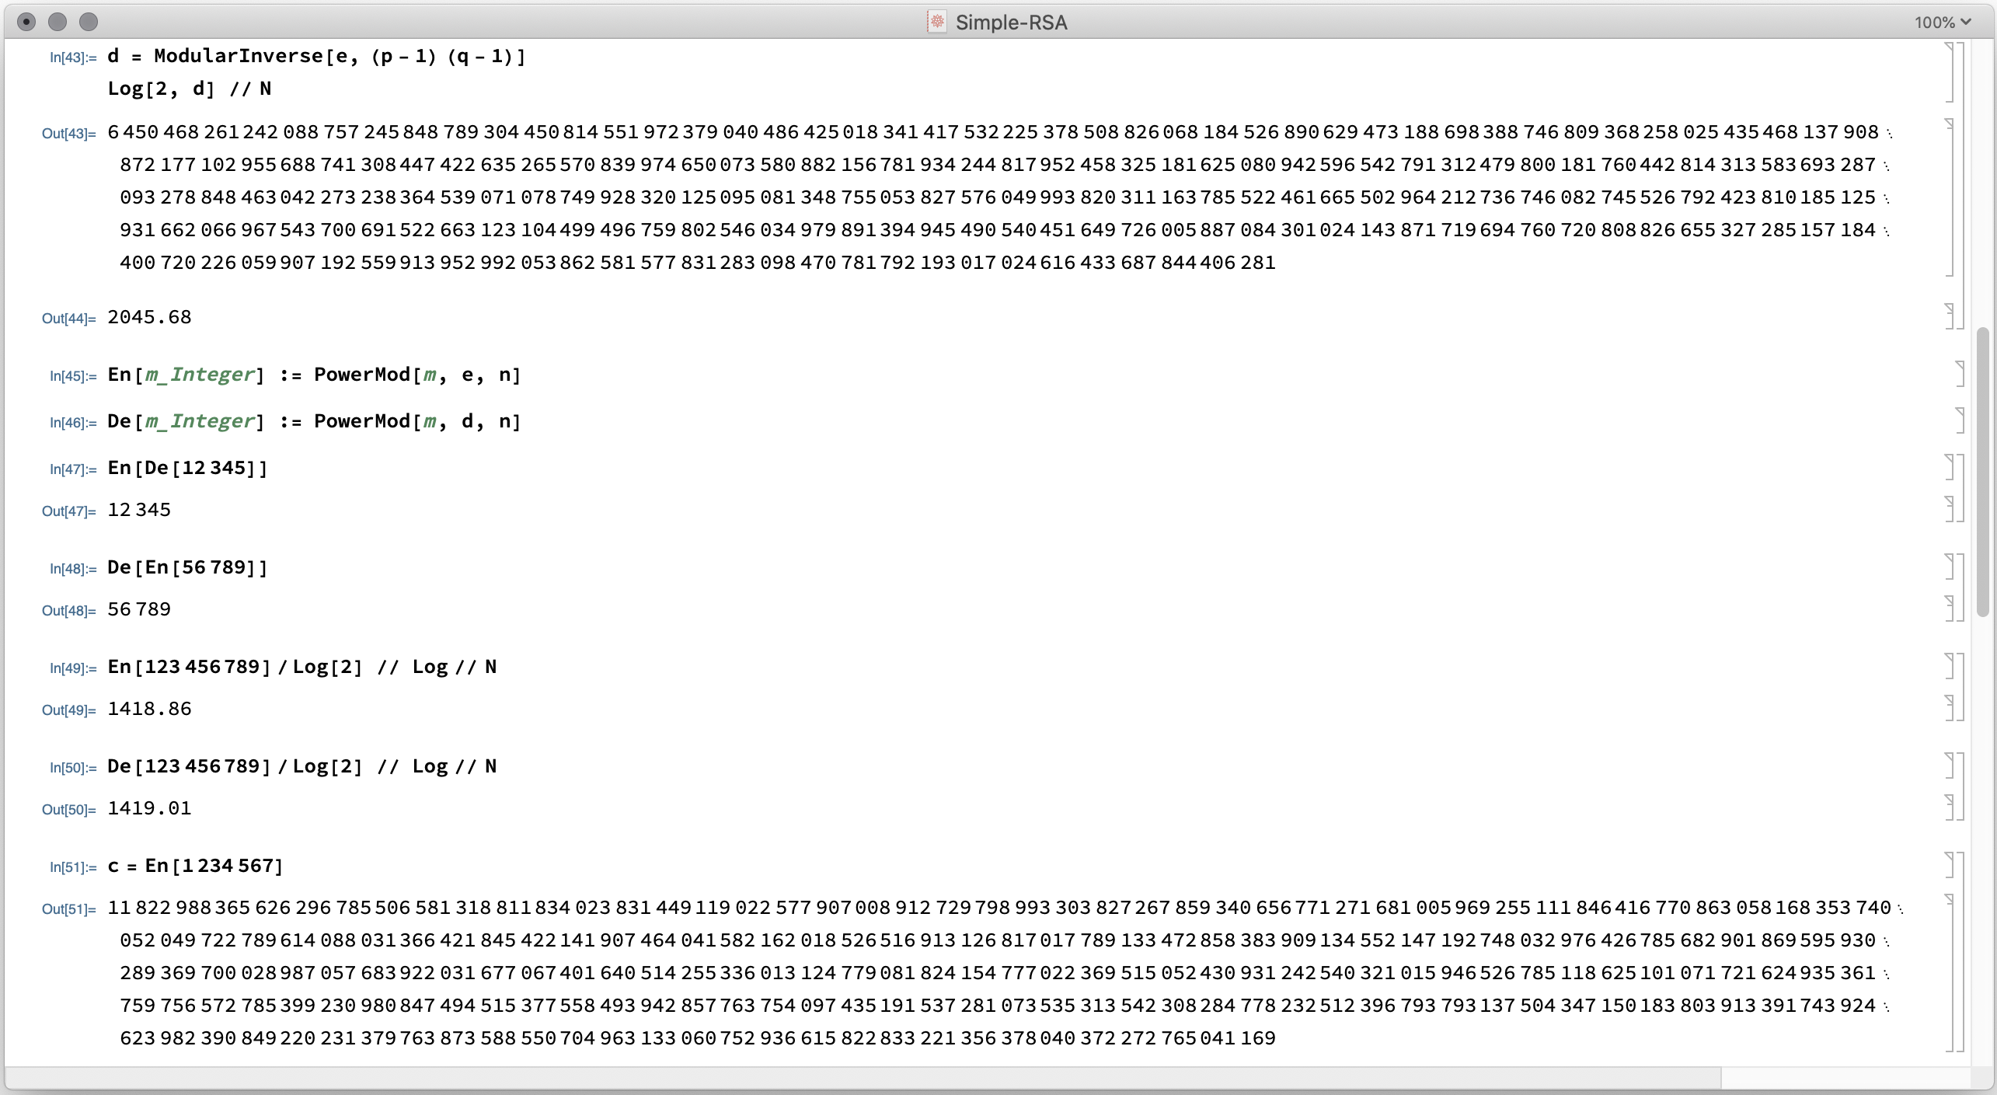

Slide 10
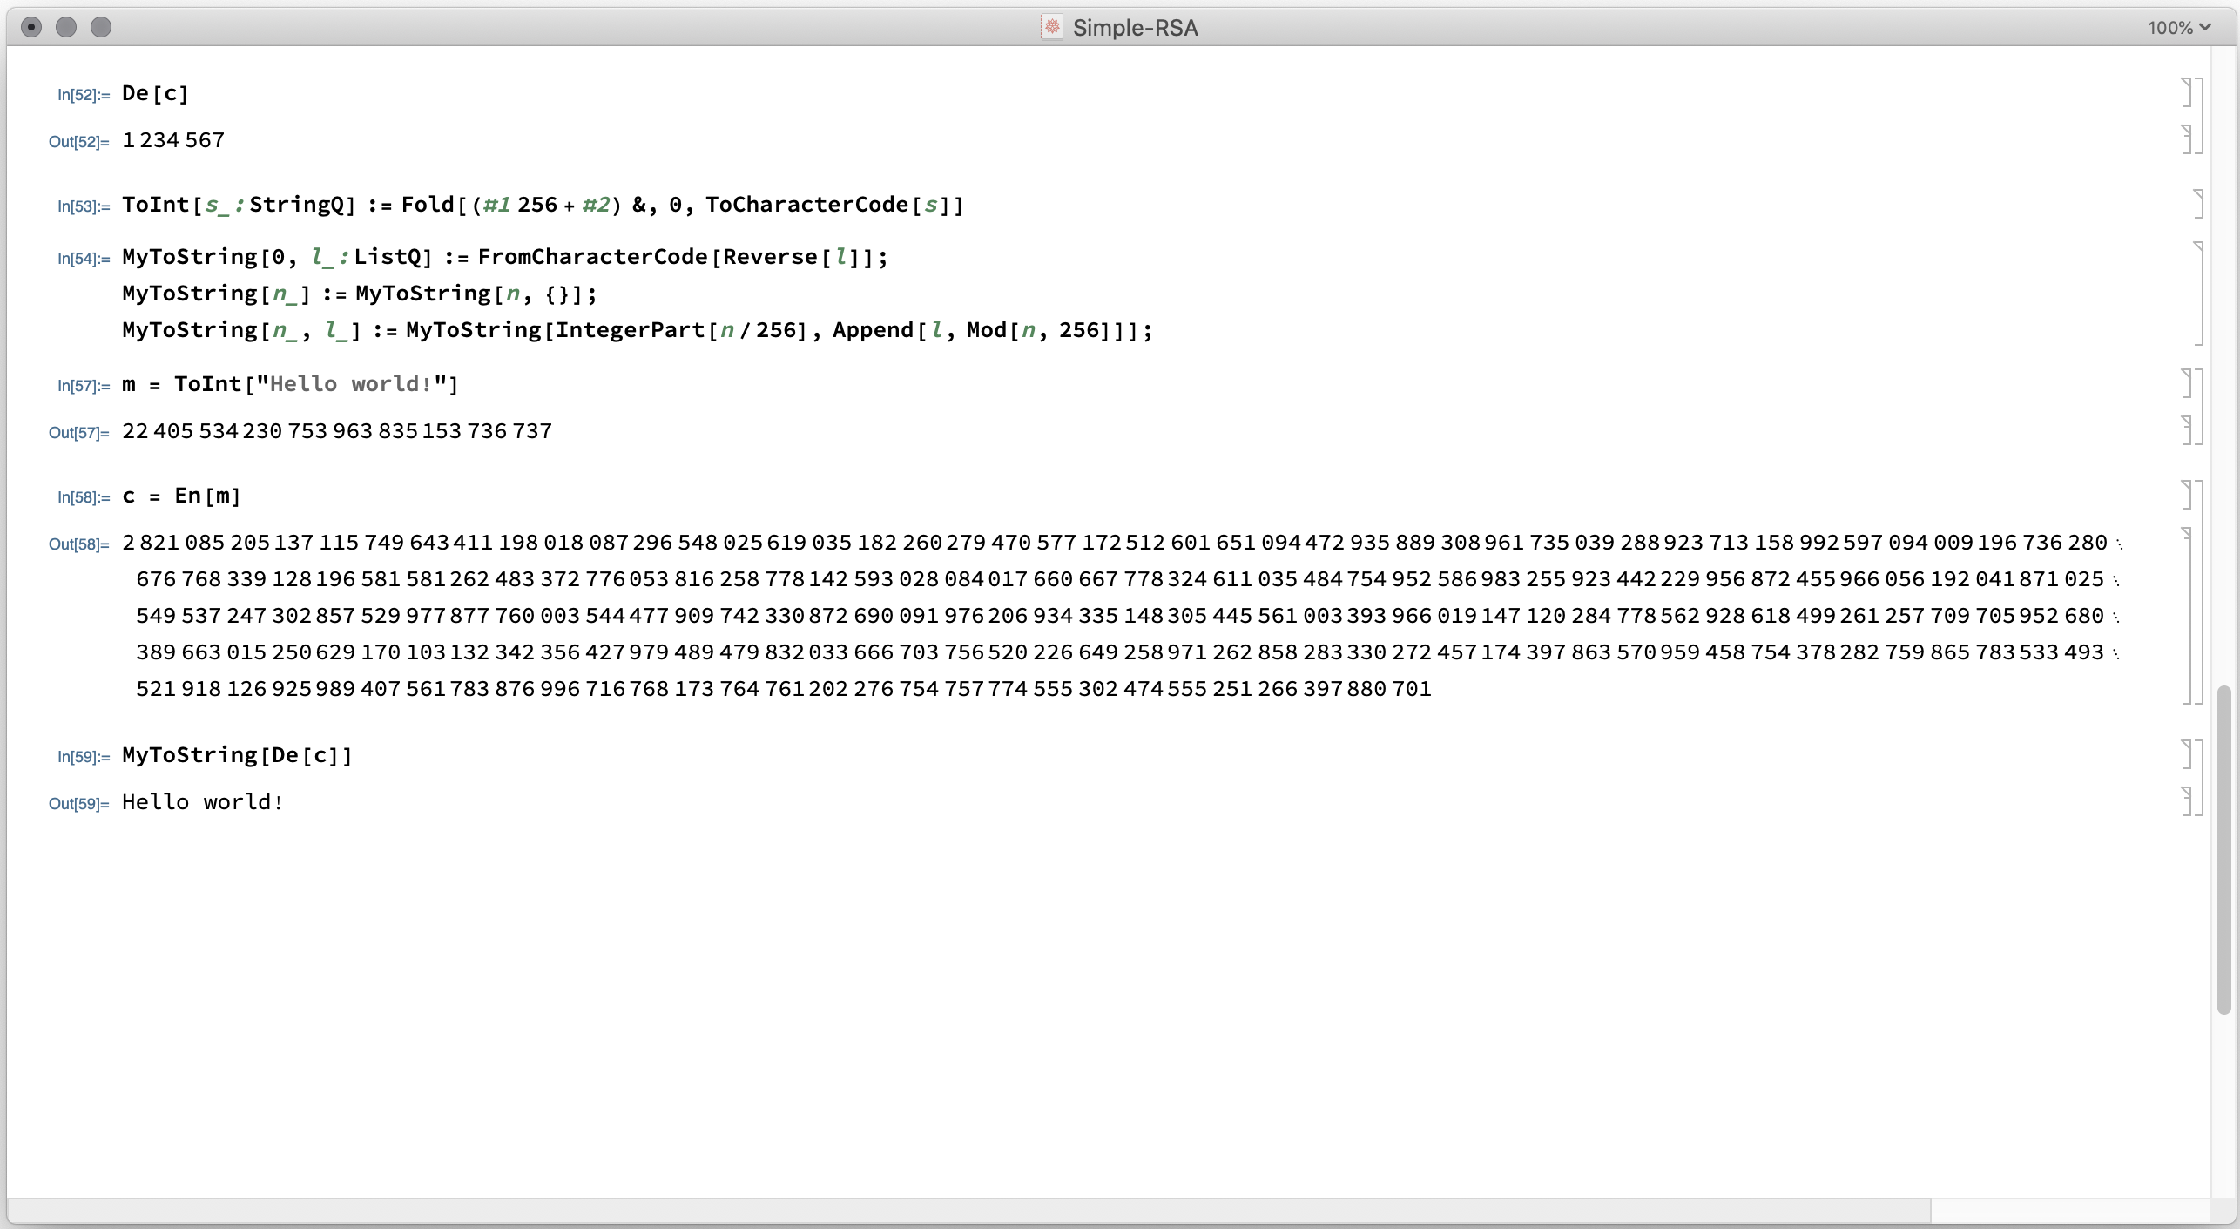

Slide 11
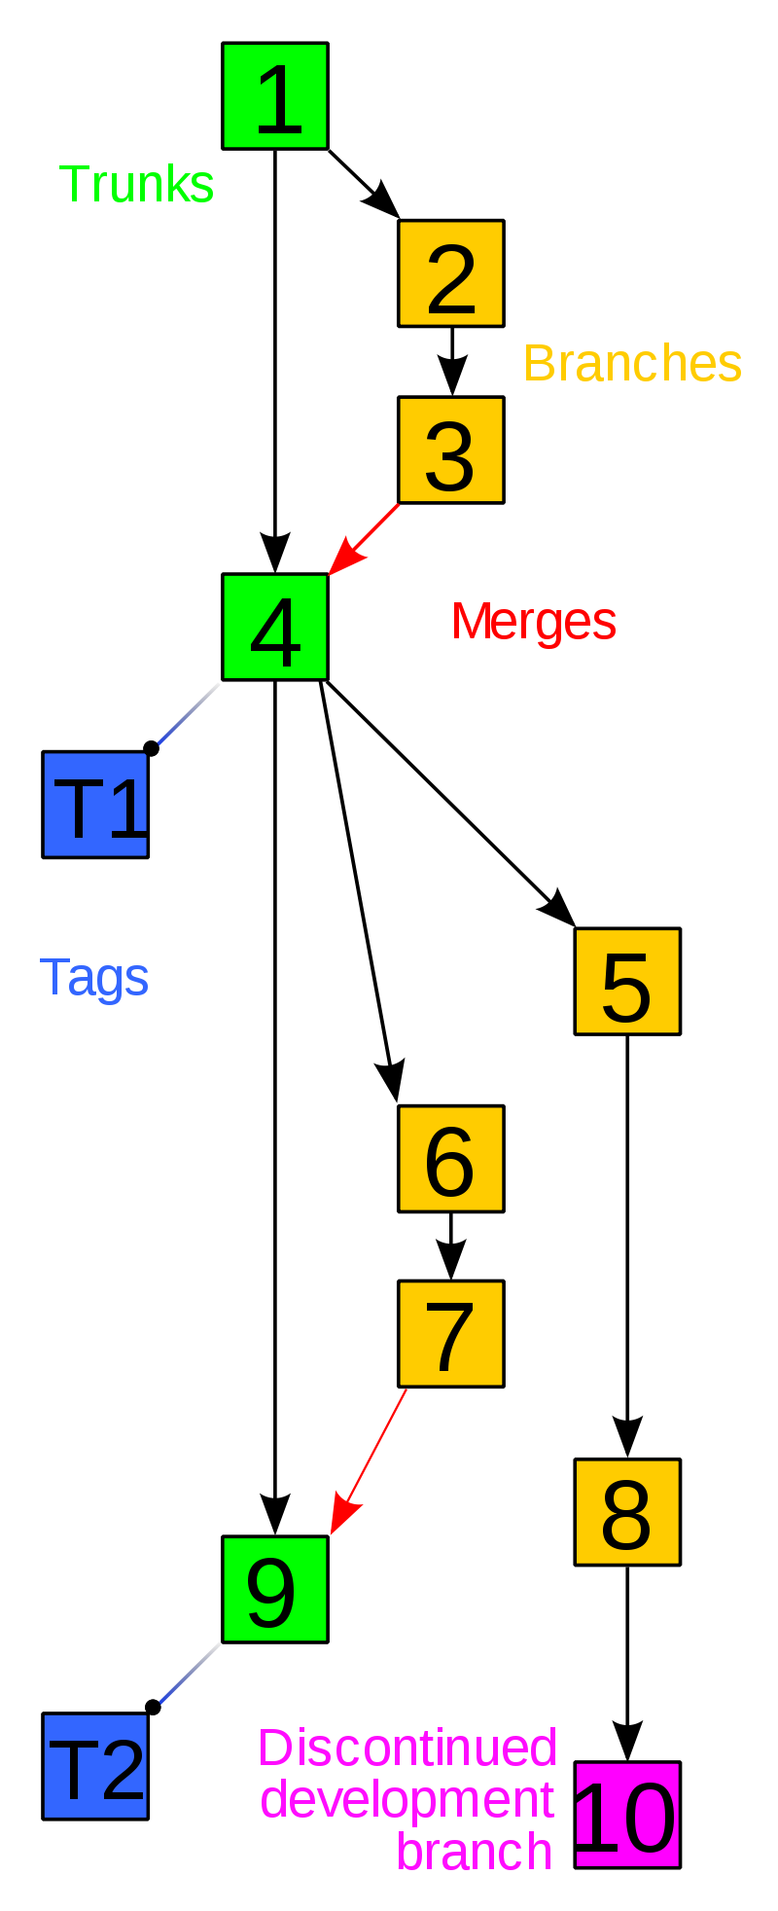
Source Code Control
git is the source control system that you will use during your education.
It is among the most widely used.
Keeps multiple versions of your files.
That means if you make a mistake you can go back to an earlier version.
You can share your files with others in a controlled fashion, and
You can reconcile divergent versions of your files.
Files are stored in a repository.
Stores are opaque chunks (do not mess with them).
The repository represents the history of each file.
You have a local repository that you can synchronize with the one stored on the server.

Slide 12
A little more about git
Files are stored in a repository
The .git directory contains indexing information and a content-addressable store of file chunks.
A set of git commands for manipulating the repository:
Use only the git commands,
Do not mess with the contents of .git (bad things will happen).
If you do then you can clone a new copy from the server,
If you commit and push regularly.

Slide 13
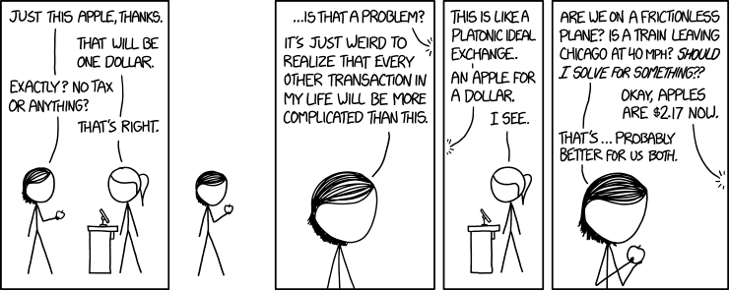
Good News! Most of the time it is not complicated at all.
Notes:
Credit xkcd: https://xkcd.com/2019/

Slide 14
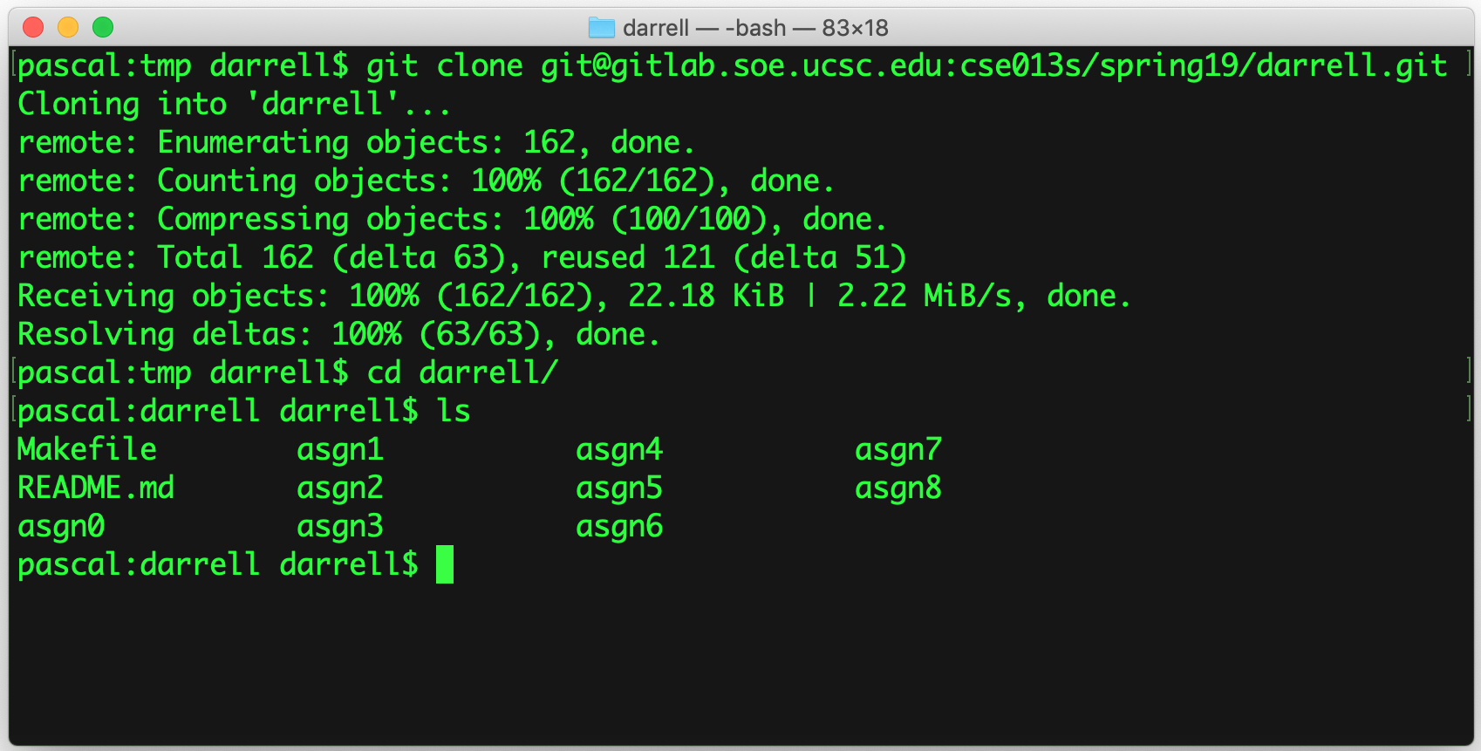
git clone
This command makes a copy of the remote repository stored on the server.
You can clone this directory in any place you like, as many times as you like.
It will be prepopulated with the directories that you need for this class.

Slide 15
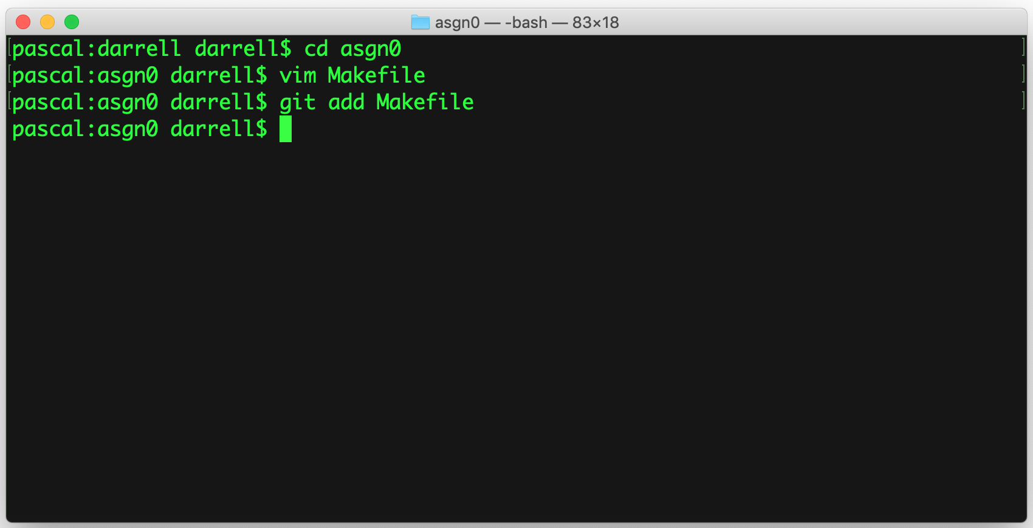
git add
git add file₁ file₂ file₃ …
Adds files to your repository and causes git to track changes to those files.

Slide 16
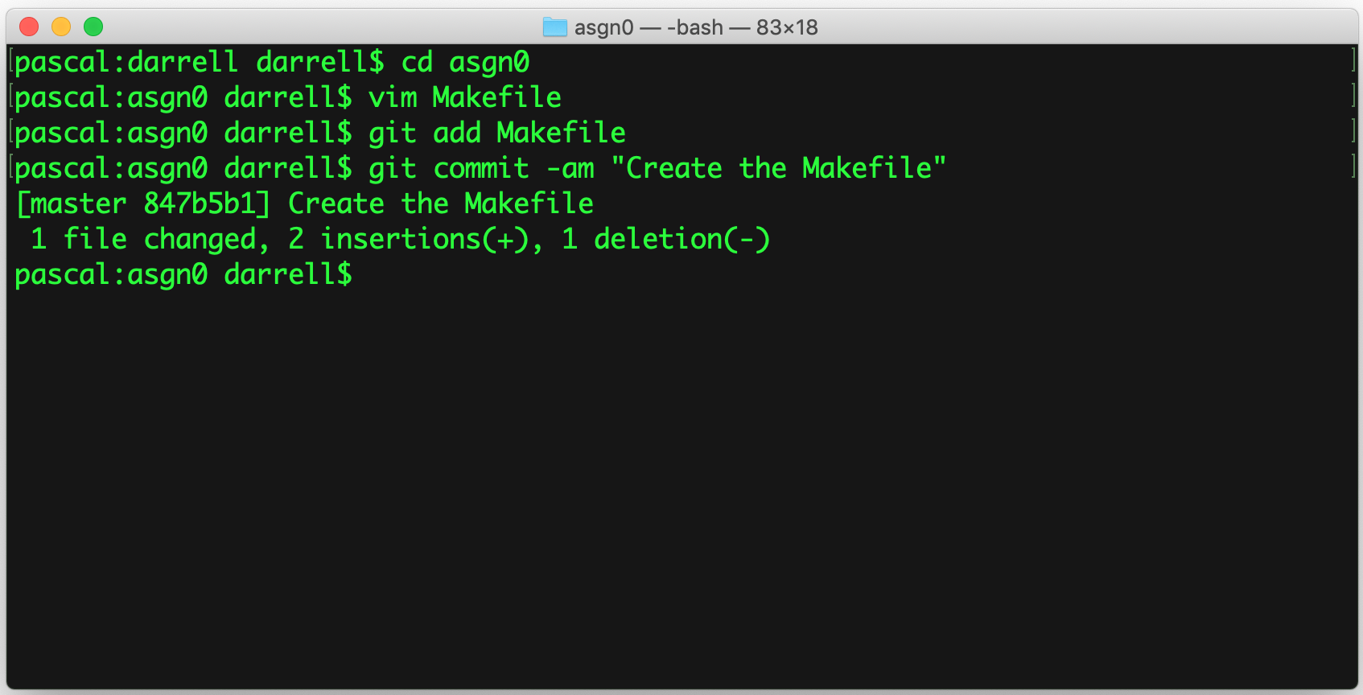
git commit
Issuing a commit sets a point in time (a version) of your file.
git commit –am “msg”
-a means all files
-m specifies a commit message

Slide 17
This should not be you!
The commit message should describe what you did since the last commit.
It will help you find a stable version when you mess things up!

Slide 18
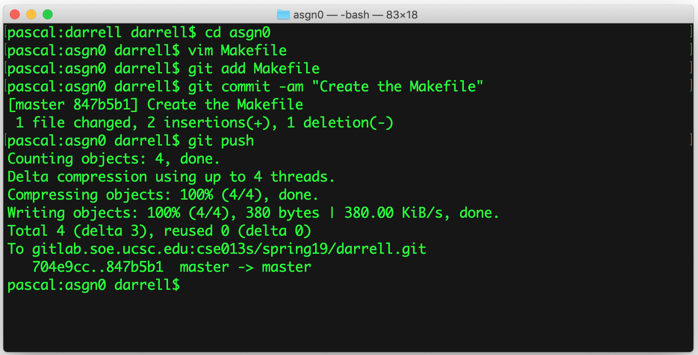
git push
Sends your local changes to the remote repository.
It’s a common mistake to forget to push, but
If you do not push then we cannot grade your code.

Slide 19
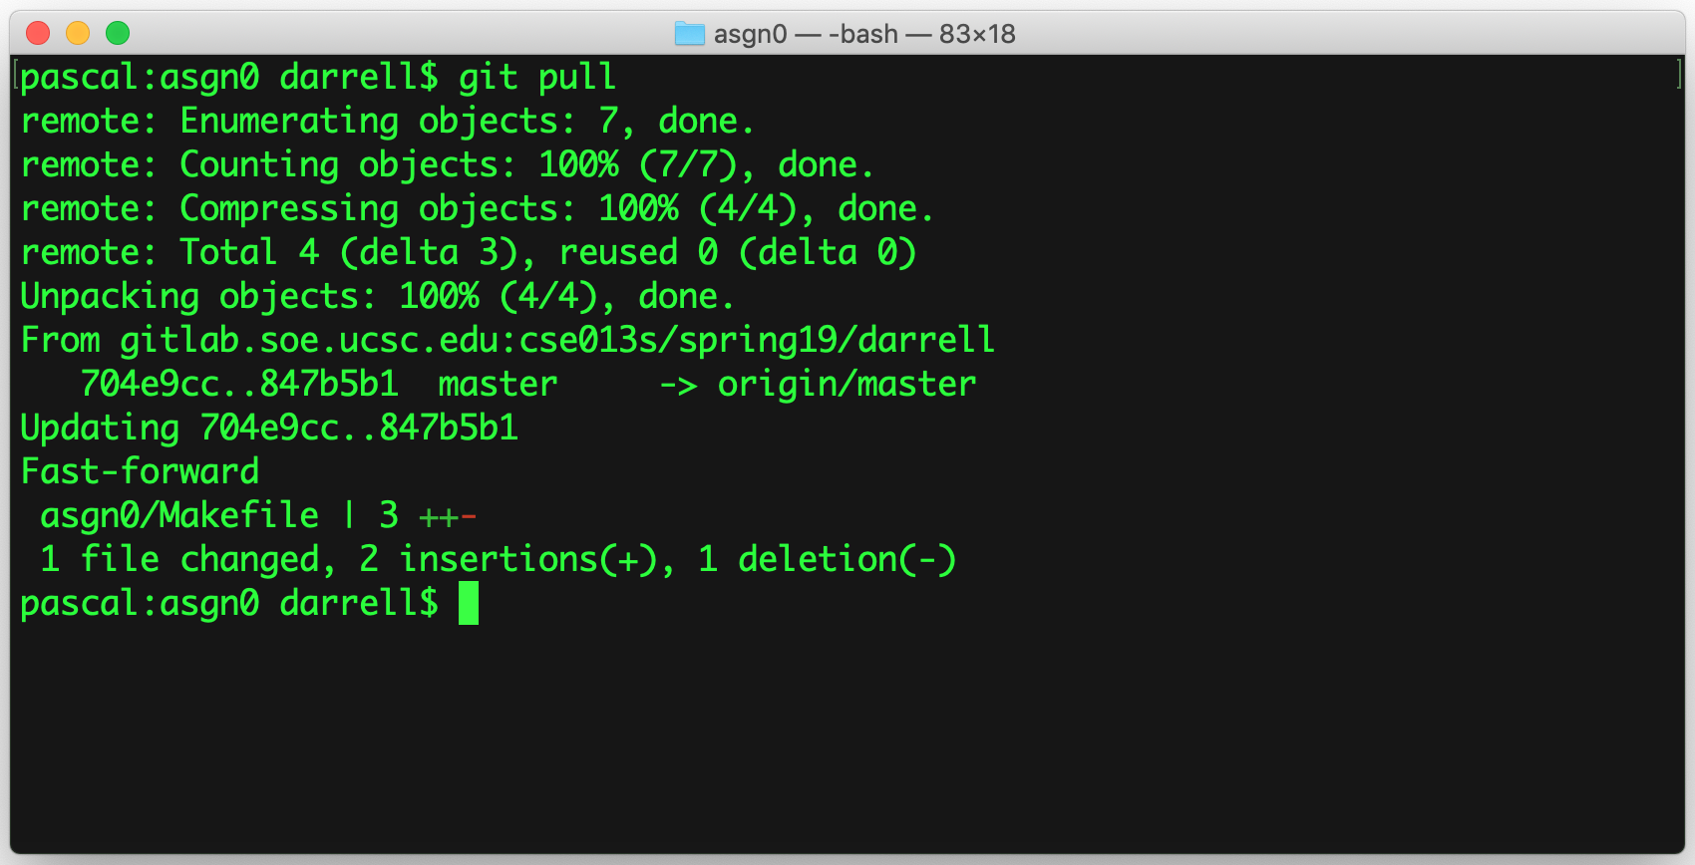
git pull
Brings your local repository up-to-date from the remote repository.
Will merge in changes that appear in the other branch (perhaps made by your collaborator).
There are many options that deal with tags, branches, and other details.
You are strongly advised at this point in your education to keep it simple.

Slide 20
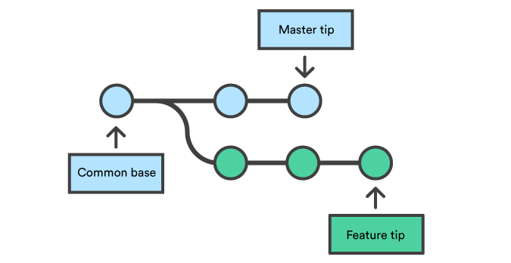
Branching
git stores your repository as a sequence of commits:
Each commit created a new node.
These commits form a directed acyclic graph (DAG).
You can have a local development branch separate from the master branch.
Notes:
Credit: Atalassian tutorial

Slide 21
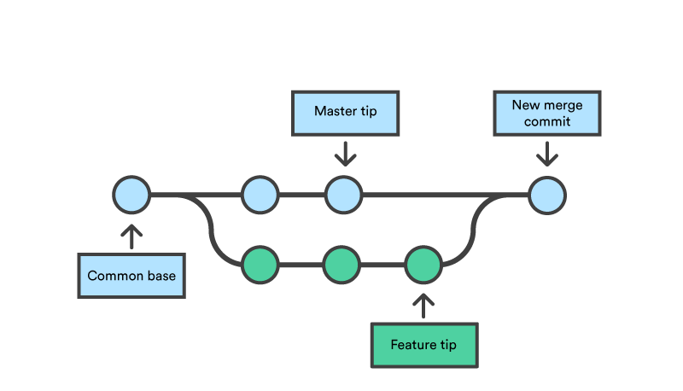
git pull --merge
Merging allows you to combine two or more branches.
Trivial changes will be automatically applied.
git is not magic, and if there are conflicts you will have to resolve them.

Slide 22
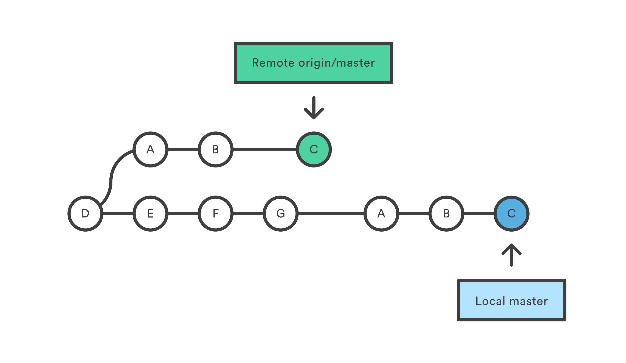
git pull --rebase
Brings in the history from the remote repository.
Applies them to your local respository.

Slide 23
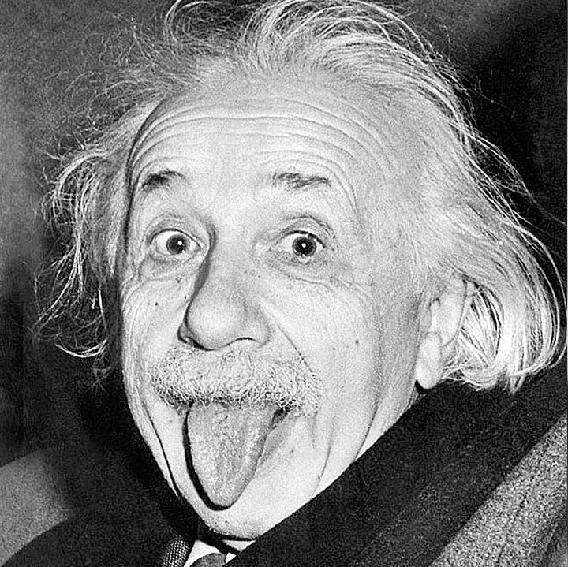
Make it as simple as possible, but no simpler…
Clone your repository on your virtual machine
Clone your repository on unix.ucsc.edu
Clone is as many times as you like!
Use git push and git pull to transfer files
Do no make things unnecessarily complicated.
Avoid FileZilla and programs like it.

Slide 24
Summary
git is a powerful but complex tool.
If you use it correctly, it will save you from many unpleasant situations.
git tracks each commit, so you can always go back to a previous commit.
If you only use it to submit your assignments then you are missing the point and lose all the benefits.
Take the time to work through a tutorial:
https://www.atlassian.com/git/tutorials/learn-git-with-bitbucket-cloud

Slide 25
It’s really not that hard — But it can be if you try…

Slide 26
Finally
Commit regularly, and
Do not forget to push!

